Slide 1
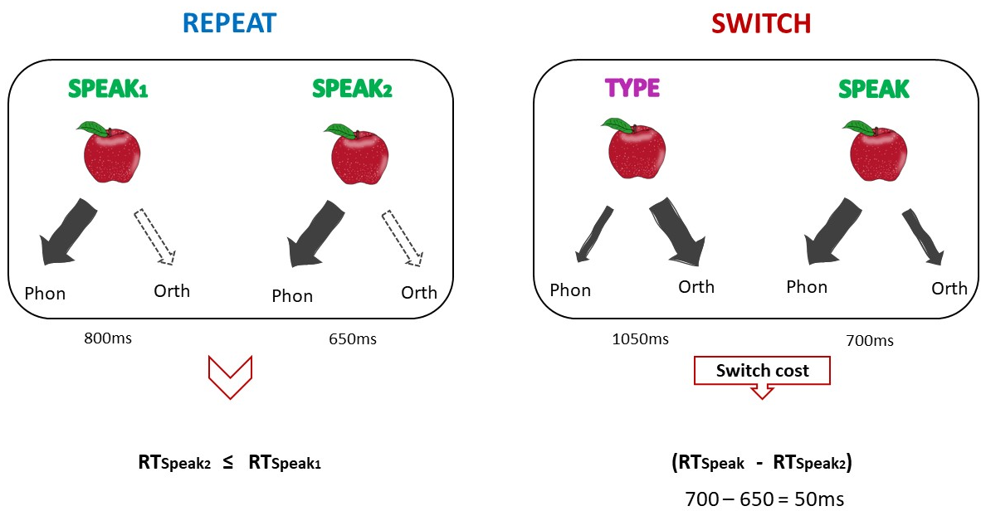
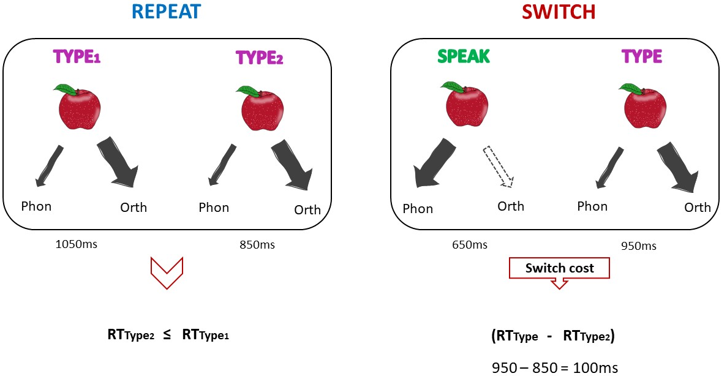
(RTSpeak - RTSpeak2) < (RTType - RTType2)
50ms < 100ms
Asymmetrical switch cost
Notes:
If phonology is strongly co-activated when typing and orthography is weakly co-activated when speaking, larger switch costs to typing than to speaking are expected for the same item.

Slide 2
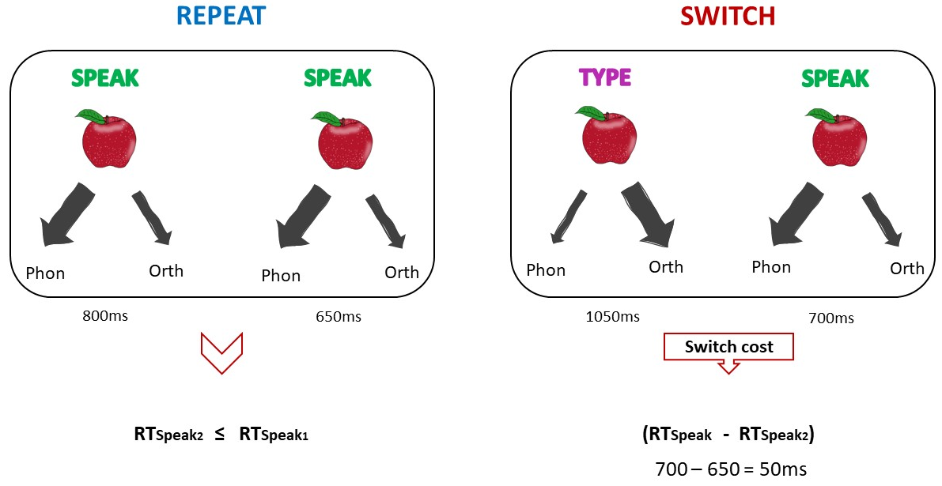
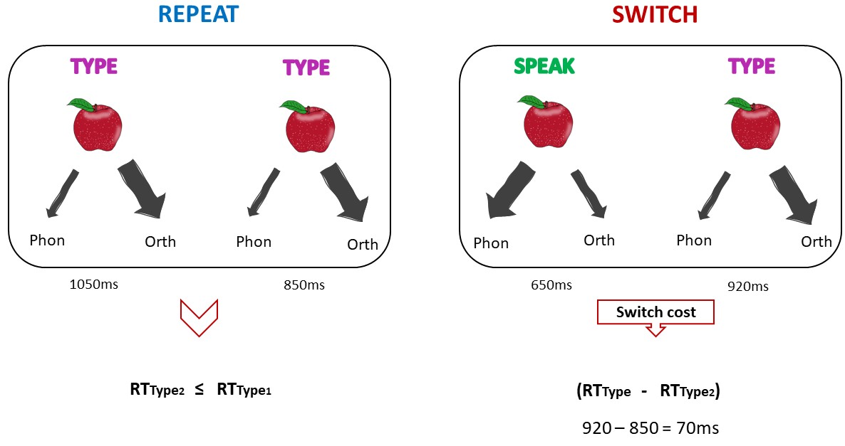
(RTSpeak - RTSpeak2) < (RTType - RTType2)
50ms < 70ms
Asymmetrical switch cost
Notes:
If orthography is also strongly co-activated when speaking (and phonology when typing), no larger costs are expected to speaking than to typing.

Slide 3

REPEAT
SWITCH
SPEAK1
SPEAK2
TYPE
SPEAK
Phon
Orth
Phon
Orth
Phon
Orth
Phon
Orth
800ms
650ms
1050ms
700ms
Switch cost
RTSpeak2 ≤ RTSpeak1
(RTSpeak - RTSpeak2)
700 – 650 = 50ms
Notes:
If phonology is strongly co-activated when typing and orthography is weakly co-activated when speaking, larger switch costs to typing than to speaking are expected for the same item.

Slide 4
REPEAT
SWITCH
TYPE1
TYPE2
SPEAK
TYPE
Phon
Orth
Phon
Orth
Phon
Orth
Phon
Orth
1050ms
850ms
650ms
950ms
Switch cost
RTType2 ≤ RTType1
(RTType - RTType2)
950 – 850 = 100ms
Notes:
If phonology is strongly co-activated when typing and orthography is weakly co-activated when speaking, larger switch costs to typing than to speaking are expected for the same item.

Slide 5
REPEAT
SWITCH
SPEAK
SPEAK
TYPE
SPEAK
Phon
Orth
Phon
Orth
Phon
Orth
Phon
Orth
800ms
650ms
1050ms
700ms
Switch cost
RTSpeak2 ≤ RTSpeak1
(RTSpeak - RTSpeak2)
700 – 650 = 50ms
Notes:
If orthography is also strongly co-activated when speaking (and phonology when typing), no larger costs are expected to speaking than to typing.

Slide 6
REPEAT
SWITCH
TYPE
TYPE
SPEAK
TYPE
Phon
Orth
Phon
Orth
Phon
Orth
Phon
Orth
1050ms
850ms
650ms
920ms
Switch cost
RTType2 ≤ RTType1
(RTType - RTType2)
920 – 850 = 70ms
Notes:
If orthography is also strongly co-activated when speaking (and phonology when typing), no larger costs are expected to speaking than to typing.

Slide 7
Asymmetrical modality switching
Type1 – Type2
Speak – Type
Speak1 – Speak2
Type – Speak
(Type2 – Type) > (Speak2 – Speak)

Slide 8
SPEAKING
TYPING
Type – Type
Speak – Type
>
Speak – Speak
Type – Speak
Phon
Orth
Phon
Orth
Notes:
The width of the arrows indicates weak or strong co-activation of representations (thin arrow: weak co-activation – thick arrow: strong co-activation).
The red boxes indicate the difference in RT/SOT between switch and repeat trials. The symbol in the middle indicates the difference of switch costs in switching from speaking to typing (above) and in switching from typing to speaking (below).

Slide 9
SPEAKING
TYPING
Type – Type
Speak – Type
= (small)
Speak – Speak
Type – Speak
Phon
Orth
Phon
Orth

Slide 10
SPEAKING
TYPING
Type – Type
Speak – Type
= (big)
Speak – Speak
Type – Speak
Phon
Orth
Phon
Orth
Notes:
Dashed orthogr.
How do we connect the one figure with the other?

Slide 11
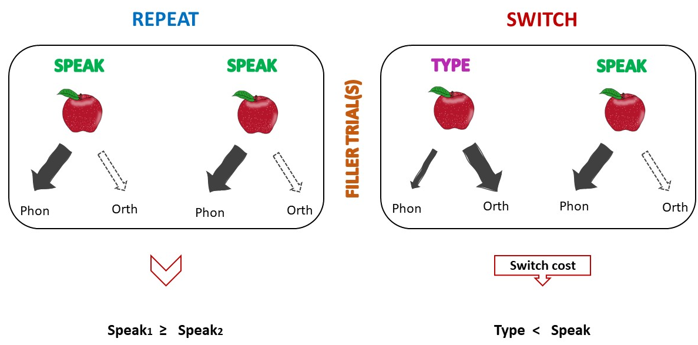
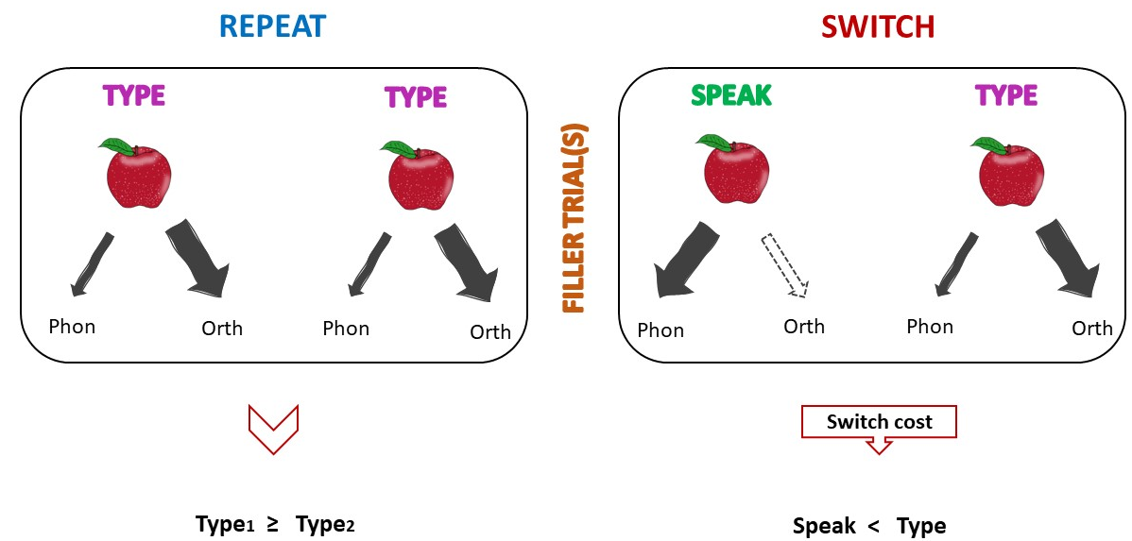
(Speak2 – Speak) < (Type2 – Type)
NO
Asymmetrical switch cost

